Slide 1

Covid-19 Project Presentation

Slide 2

Team Members
Anshika Singh
Vicky Khobragade
S James
Regu Nagaraju

Slide 3

Index
State wise recovery rate
Top 10 vaccinated states
Delta7 state-wise confirmed cases
Delta7 state-wise vaccination
Month-wise total confirmed cases
Category-wise count of District
Top 10 severe states
Top 10 states having highest death cases
Bottom 10 states having least death cases
Confirmed cases in a state by month
Weekly evolution of number of confirmed cases, recovered cases, deaths, tests for states.

Slide 4


Slide 5
The Recovery Rate
The recovery rate in coronavirus disease (COVID-19) refers to the percentage of people who have recovered from the disease after being infected. The recovery rate can vary depending on various factors such as age, overall health, and the severity of the illness.
Dehradun has shown maximum recovery rate across all the months

Slide 6
The Vaccination Update
According to data from the Ministry of Health and Family Welfare, as of September 2021, more than 750 million doses of COVID-19 vaccine had been administered in India, with over 215 million people receiving both doses of the vaccine. This represents a significant portion of the population, but there is still work to be done to ensure that all eligible individuals receive their doses.India had approved three COVID-19 vaccines for emergency use: Covishield, Covaxin, and Sputnik V.
Uttar Pradesh(UP) is the most vaccinated state till date with both the doses

Slide 7
The Delta7 Variant
A new sub-lineage of the Delta variant called Delta Plus (B.1.617.2.1 or AY.1), which had emerged in India and was identified as a "variant of concern" by the Indian government. The Delta Plus variant was found to have an additional mutation in the spike protein of the virus, which could potentially make it more transmissible and resistant to vaccines.
Kerala is the state with most delta7 confirmed cases till date

Slide 8
The Delta7 Variant Vaccination
Uttar Pradesh had highest number of vaccinated people for Delta7 Variant

Slide 9
Total Confirmed cases by Months
As of cutoff date of November 2021, the total number of confirmed cases of COVID-19 in India in 2020 was more than 10 million. The number of cases continued to increase rapidly in early 2021, with over 400,000 new cases reported daily. However, the number of cases began to decline later and has been decreasing steadily since then.
October is the most severe month in terms of confirmed cases

Slide 10
The number of Districts falling under each Category
Testing Ratio(tr)= No. of tests/Population
Category A: 0.05 ≤ tr ≤ 0.1
Category B: 0.1 < tr ≤ 0.3
Category C: 0.3 < tr ≤ 0.5
Category D: 0.5 < tr ≤ 0.75
Category E: 0.75 < tr ≤ 1.0
Category A: 95 Districts
Category B:225 Districts
Category C:16 Districts
Category D: 1 District
Category E: 194 Districts

Slide 11
The Death Rate
Death Rate is calculated as number of death cases in an area by number of confirmed cases in an area.
The states with high death rates which could be attributed to various factors such as population density, healthcare infrastructure, and government policies are shown below in the chart.
Nagaland has shown the highest death rate with 18.53%

Slide 12
The Highest Death Cases
As of cutoff date of September 2021, the total number of deaths due to COVID-19 in India was more than 440,000. The number of deaths due to COVID-19 in India has been one of the highest in the world.
Maharashtra has shown the highest death cases reported with a number of 160.5k

Slide 13
The Lowest Death Cases
Dehradun has shown the lowest death cases reported with a number of 37

Slide 14
The Month-wise Report
Maharashtra has shown the highest number of confirmed cases reported

Slide 15

Python
Excel and PowerPoint
MySql

Slide 16
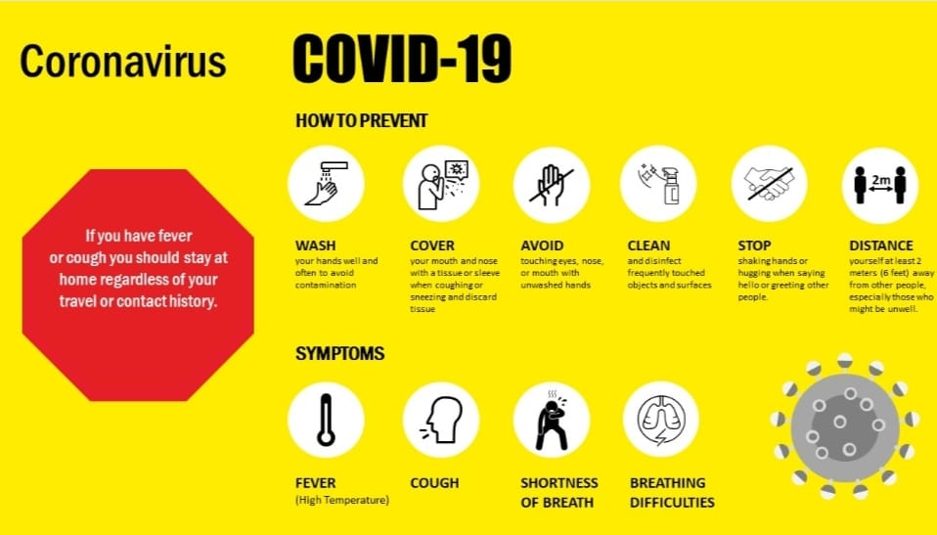

Slide 17


